Slide 1
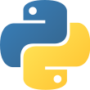
Python Programming Introduction

Slide 2
What is Python?
Python is a popular high-level programming language used in various applications.
Known for its simple syntax, making it easy to learn and use.
Can be used for basic tasks (e.g., plotting, automation) to advanced tasks (e.g., machine learning, web development).

Slide 3
Why Learn Python?
Easy to read and write (beginner-friendly).
Large community and plenty of resources.
Cross-platform (works on Windows, macOS, Linux).
Used by top companies (Google, Netflix, NASA, etc.).

Slide 4
Python in the Real World
Web Development → Django, Flask
Data Science & AI → Pandas, TensorFlow, Scikit-learn
Automation → Scripts, bots
Game Development → Pygame
IoT & Robotics → Raspberry Pi, MicroPython

Slide 5
Key Features of Python
Interpreted → No need to compile before running
Dynamically Typed → No need to declare variable types
Extensive Libraries → Thousands of pre-built packages
Open-source & Free

Slide 6
Variables
Variables are names that store values in a program
Think of them as containers or labeled boxes
They make data reusable and easy to work with

Slide 7
Creating Variables in Python
No need to declare type
Use = to assign a value
Example:
name = "Alice"
age = 20
height = 5.6

Slide 8
Variable Naming Rules
Must start with a letter or underscore _ name or _name
Can’t start with a number = 1name
No spaces (use _ instead) = first_name
Case-sensitive (Age ≠ age)
Camel case - lastName
snake case - lastname

Slide 9
Changing Variable Values
Variables can be updated anytime
Example
x = 10
x = 25

Slide 10
Multiple Variables
Assigning same value:
a = b = c = 5
Assigning different values:
x, y, z = 1, 2, 3

Slide 11
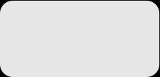
Basic Syntax Rules
Function Syntax
  def...: indicates that you are defining a new function.
  function() refers to the name of your function. By convention, this name is typically lowercase and represents a verb/action.
  a,b refers to parameters (values or variables) that can be used within the statements of your function’s definition (......). If your function has no parameters, an empty parenthetical () is used.
  The return statement is an optional statement that will return a value for your function to your original call.
def function(a, b):
......
return a + b

Slide 12

Basic Syntax Rules (cont.)
Calling a function
  Call the function by referring to its name (function()) and by placing
  any necessary arguments (1, 2) within the parenthesis separated by
  commas. myValue = function(1, 2)
  If you wish, you can set your function call equal to a variable (myValue). The value returned by the function will be assigned to your variable name.
myValue = function(1, 2)

Slide 13
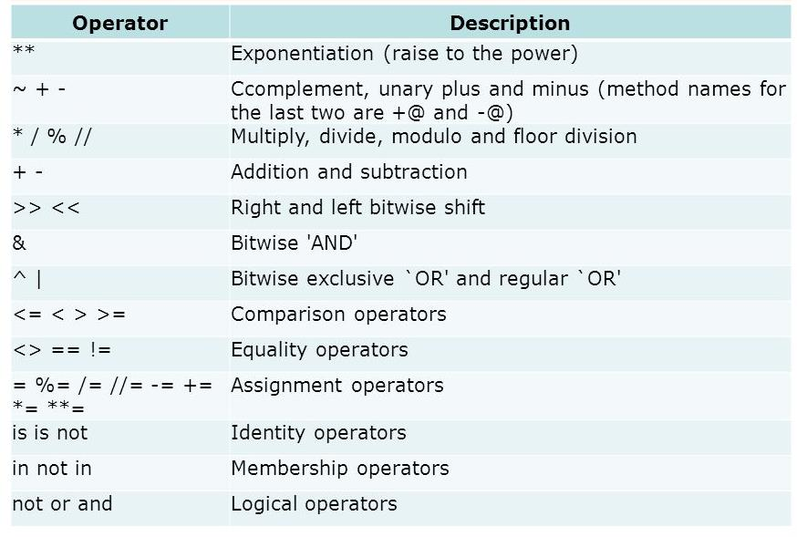
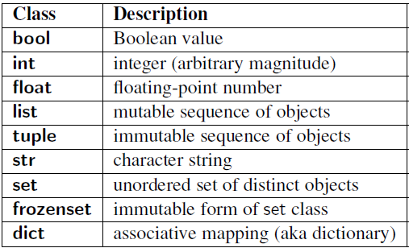
Common Data Types and Operators
A data type is a means of classifying a value and determining what operations can be performed on it. All objects have a data type.
Operators are symbols used carry out specific functions/computations.
https://www.youtube.com/watch?v=v5MR5JnKcZI

Slide 14

Input/Output
Input functions (input()) allow users of a program to place values into programming code.
  The parameter for an input function is called a prompt. This is a string (this can be indicated by “” or ‘’) such as “Enter a number: “
  The user’s response to the prompt will be returned to the input statement call as a string. To use this value as any other data type, it must be converted with another function (int()).
Print functions (print()) allow programs to output strings to users on a given interface.
  The parameter of this function is of any type. All types will automatically be converted to strings.
xString = int(input(“Enter a number: “))
y=xString+2
print(y)

Slide 15

If-else Statements
If-else statements allow programmers to adapt the function of their code based on a given condition.
If a given condition (i.e. x % 2 == 0) is true, then the statements following the if statement (if) will be executed. If the condition is false, the statements following the else statement (else) will be executed.
  The condition is tested using the Boolean operators == (is equal to), != (is not equal to), and (used to test multiple conditions), and or (used to test if AT LEAST ONE condition is true).
  Additionally, else-if statements (elif) can be used to provide unique coding statements for multiple conditions.
xString = input(“Enter a number: “)
x = int(xString)
if x % 2 == 0:
print(“This is an even number”)
elif x == 0:
print(“This number equals 0”)
else:
print(“This is an odd number”)

Slide 16

For Loops
For loops perform the same task (iterate) for the number of times specified by an iterable (something that can be evaluated repeatedly such as a list, string, or range).
for defines the for loop
x is the variable defining the number of times the statements within the loop (print(myInt)) are executed.
The range(start, stop, step) function is often used to define x.
  The starting value is defined by start, the final value is defined by stop – 1, and the magnitude at which x changes between loops is defined by step.
in is a Boolean operator that returns true if the given value (x) is found within a given list, string, range etc.
myString = input(“Enter a number: “)
myInt = int(myString)
for x in range(0, 5, 1):
print(myInt)

Slide 17

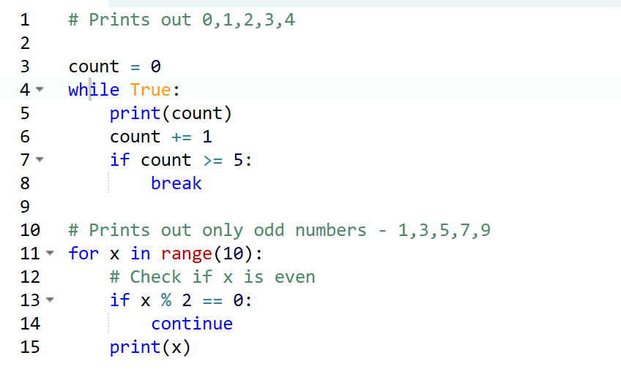
While Loops
myString = input(“Enter a number: “)
myInt = int(myString)
x = 0
while x < 5:
print(myInt)
x= x +1
While loops are statements that iterate so long as a given Boolean condition is met.
  x (the variable determining whether or not the condition is met) is defined and manipulated OUTSIDE of the header of the while loop (while)
  The condition (x < 5) is a statement containing a Boolean variable.
  break is a statement used to exit the current for/while loop.
  continue is a statement used to reject all statements in the current for/while loop iteration and return to the beginning of the loop.

